Slide 1
Getting Started with Windows 10
Andrew Moll

Slide 2
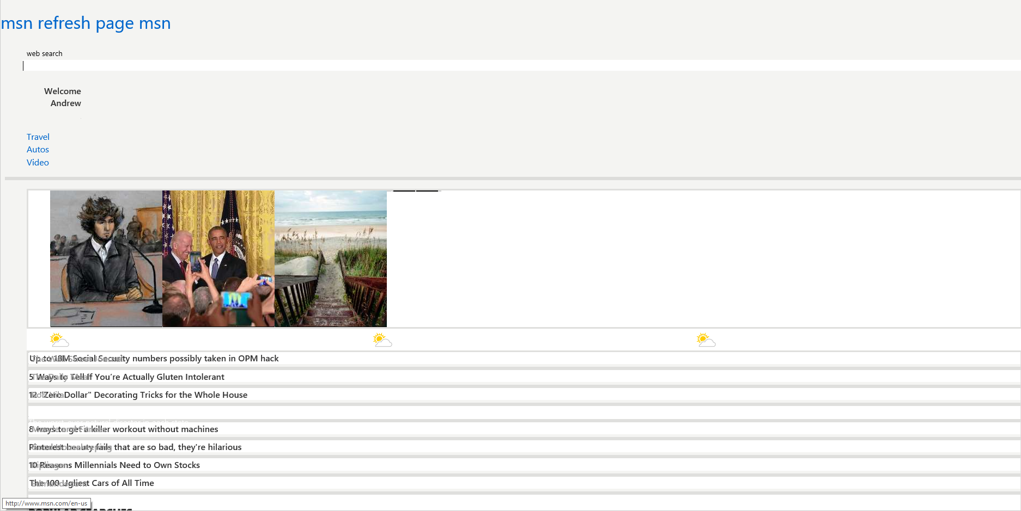

Slide 3







11
E
Always up-to-date
Update frequently
Single doc model
Always up-to-date
Update frequently
Single doc model
10
9
8
7
Q
14
12
13
34
35
Firefox
5
Chrome

Slide 4
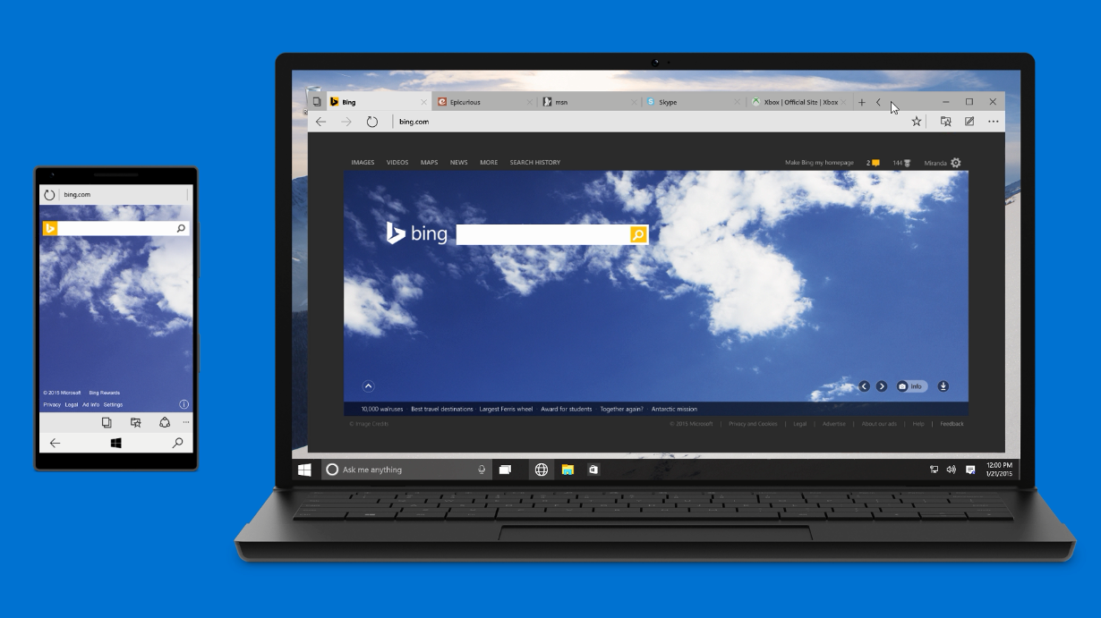
Microsoft Edge
Aka “Project Spartan”
Only browser with Cortana, to get more done on the web
Distraction-free, offline reading
Built-in note-taking & sharing

Slide 5
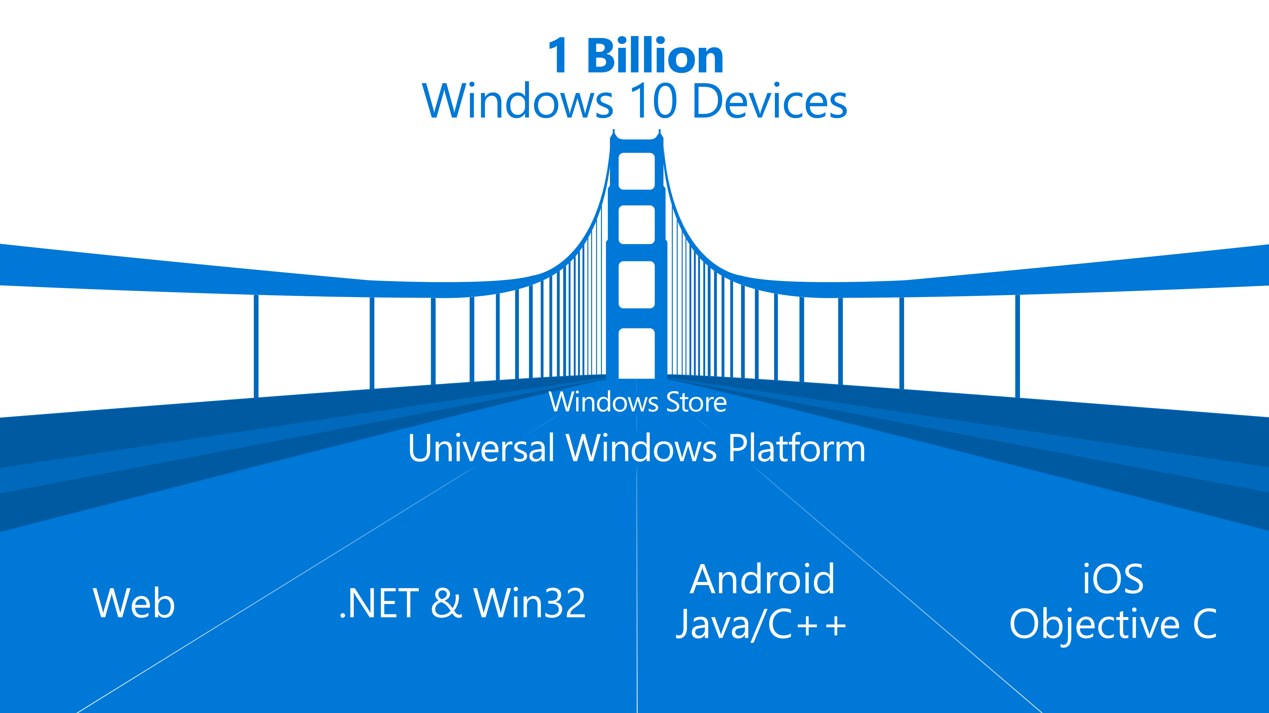

Slide 6

The convergence journey
Xbox 360
Xbox One
Unified core and app platform
Converged
OS kernel
Windows 8.1
Windows 8
Converged
app model
Windows 10
Windows Phone 8.1
Windows Phone 8
Easy for users to get & stay current
Windows Phone 7.5
Windows on Devices
Notes:
OS Kernal allowed for multi core etc. But win 8.1 had similar but not identical across. They were using Silverlight which we still don’t really use
Now nirvana with win 10 which is the truly converged dev platform.

Slide 7

Introducing the UWP

Slide 8
Windows Core
The refactored common core
One hardware platform
Universal hardware driver
Standard network and I/O
Desktop SKU
Phone SKU
Xbox SKU
Windows Core
Desktop
Device
Phone
Device
Xbox
Device
Notes:
Windows core

Slide 9
One Windows
Desktop SKU
Mobile SKU
Xbox SKU
IoT SKU
IoT headless SKU
Surface Hub SKU
Holographic SKU
PC
2 in 1
Tablet
Phablet
Phone
Xbox
Band
Raspberry Pi
Surface Hub
HoloLens
Home Automation

Slide 10
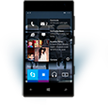

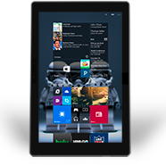
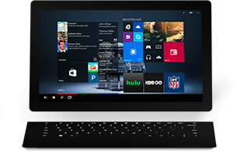

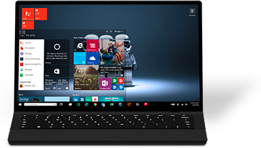

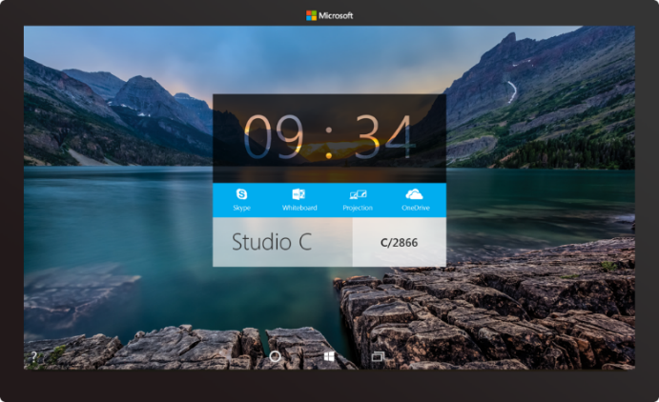

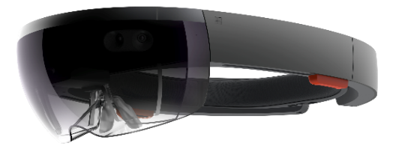



2-in-1s (Tablet or Laptop)
Classic Laptop
Desktops & All-in-Ones
Phone
Phablet
Small Tablet
Large Tablet
Windows 10
Surface Hub
Xbox
Holographic
IoT

Slide 11
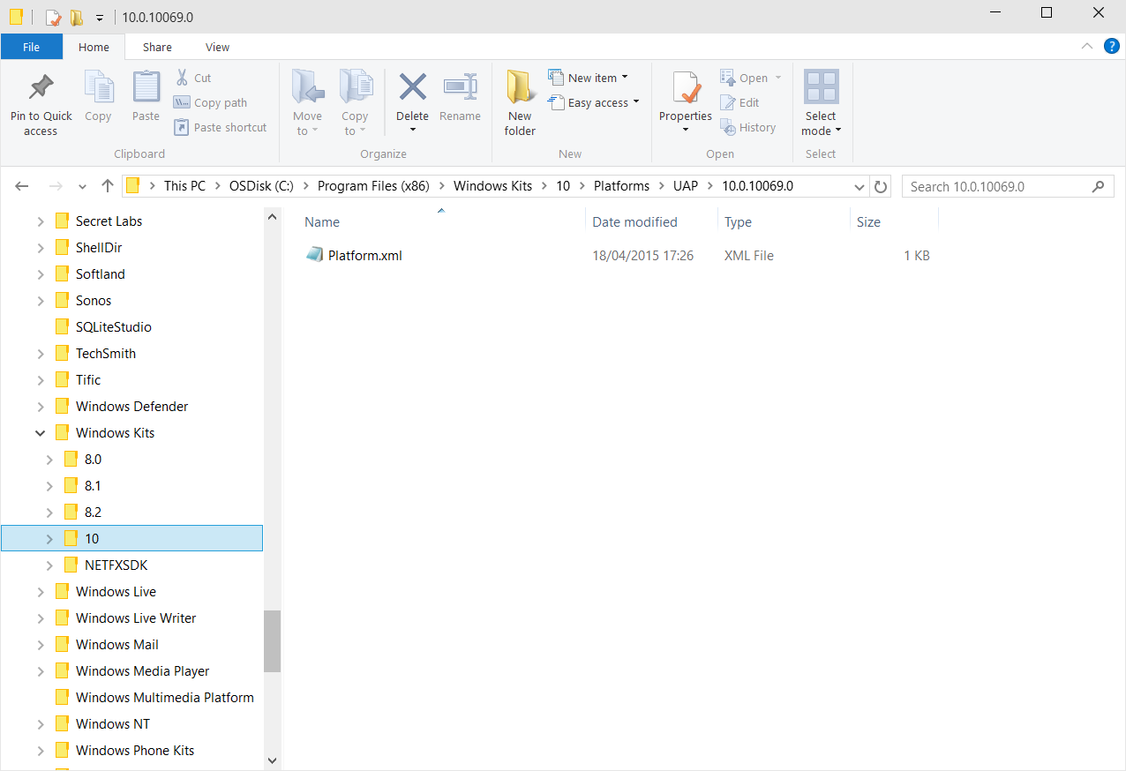
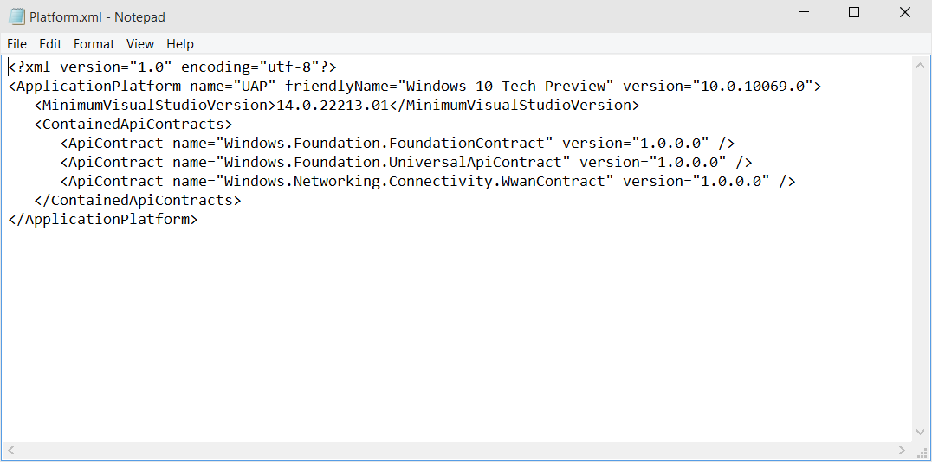
Universal Windows Platform
A single API surface
A guaranteed API surface
The same on all devices
Universal Windows Platform
Windows Core
Desktop
Device
Phone
Device
Xbox
Device
Notes:
UWP is the api that works across all of the device skus. If we have a method call in one it will work across all of the sku’s. These are the same everywhere. This xml file carries the guarantee from Microsoft saying these are available across all devices, trust us. This is really the win RT/phone api’s wrapped up a little differently and added to.

Slide 12
Apps don't target Windows 10, apps target the platform
Notes:
Don’t write apps to target win 8 or phone etc. They now target just the platform and the api’s

Slide 13
<TargetPlatform
Name="Microsoft.Universal"
minVersion="10.0.10069.0"
maxVersionTested="10.0.10190.0"/>
Notes:
Min version- I wrote the app for this
I tested it on this version.
Imagine the store handing this ☺

Slide 14
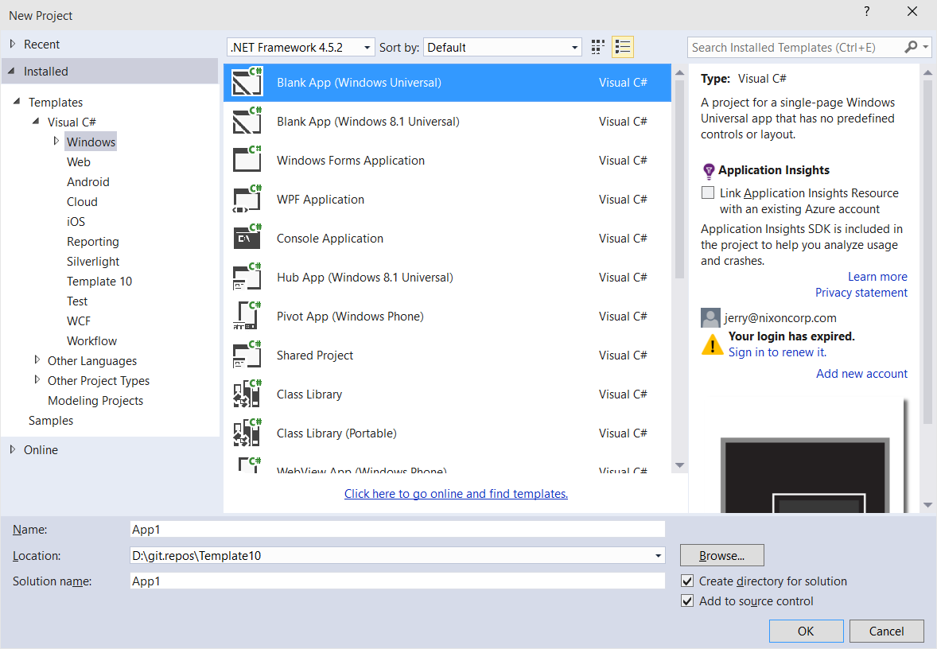
Windows app
A single binary
Running on any device
Testing for capabilities
Adjusting to devices
Windows App
Universal Windows Platform
Windows Core
Desktop
Device
Phone
Device
Xbox
Device
Notes:
Theoretically you could write one app package that would span across all of the devices. Not many use cases but theoretically you could do this… You can constrain it down to the devices that make sense for your app. Obviously.

Slide 15
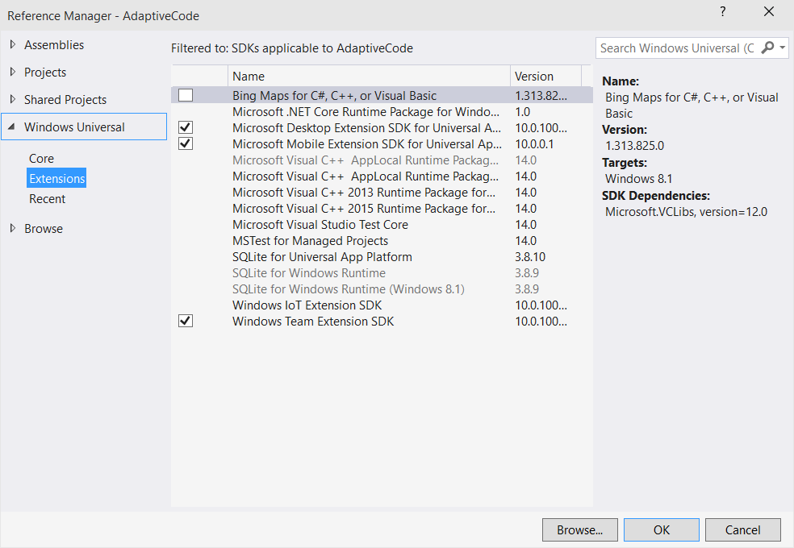
Platform extensions
Device-specific API
Family-specific capabilities
Compatible across devices
Unique update cadence
Windows App
Desktop
extension
Phone
extension
Xbox
extension
Universal Windows Platform
Windows Core
Desktop
Device
Phone
Device
Xbox
Device

Slide 16
Extensions don't invalidate binaries on other devices

Slide 17
The device families you choose determines which APIs you can call freely

Slide 18
Test capabilities at runtime
Use Adaptive Code to light-up your app on specific devices
var api = "Windows.Phone.UI.Input.HardwareButtons";
if (Windows.Foundation.Metadata.ApiInformation.IsTypePresent(api))
{
Windows.Phone.UI.Input.HardwareButtons.CameraPressed += CameraButtonPressed;
}

Slide 19
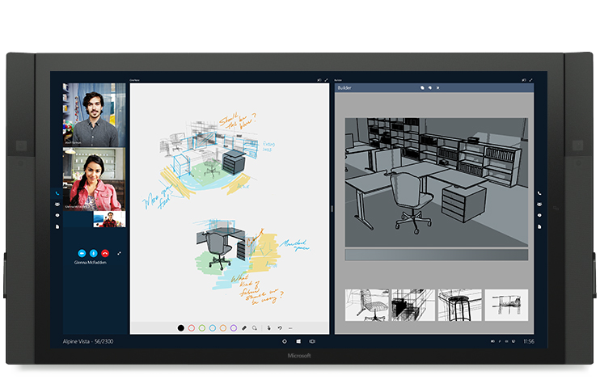
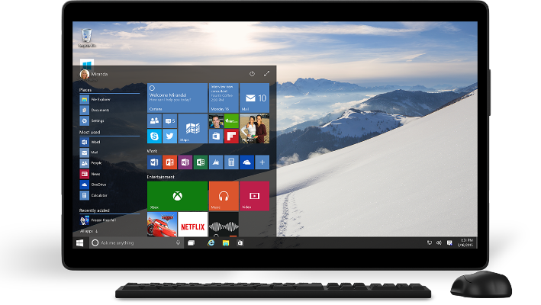
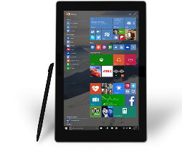
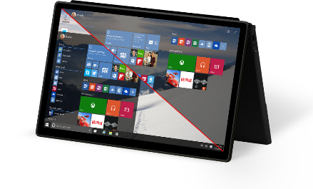
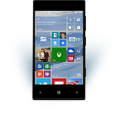
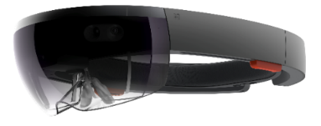
Universal Windows Platform
One Operating System
One Windows core for all devices
One App Platform
Apps run across every family
One Dev Center
Single submission flow and dashboard
One Store
Global reach, local monetization Consumers, Business & Education
Notes:
Dev enters are separate for win 8 and win phone. MSDN has now been converged as well.

Slide 20
Adaptive design
Responsive design
Flexible layout responds to small changes
Many controls handle basic responsiveness
Adaptive design
Smart layout adjusts to large changes
Features like visual states aid in this design
Tailored design
A device-specific app can simplify design
Some devices have unique design languages

Slide 21
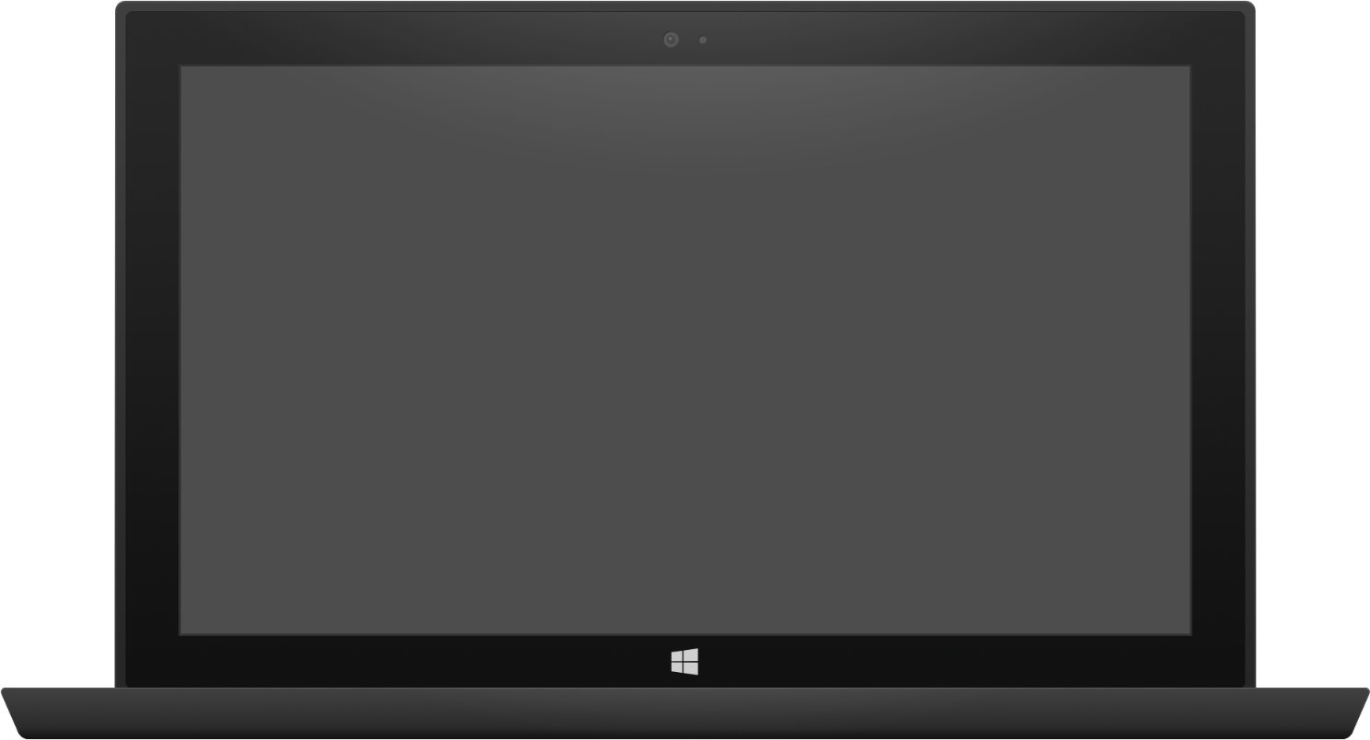

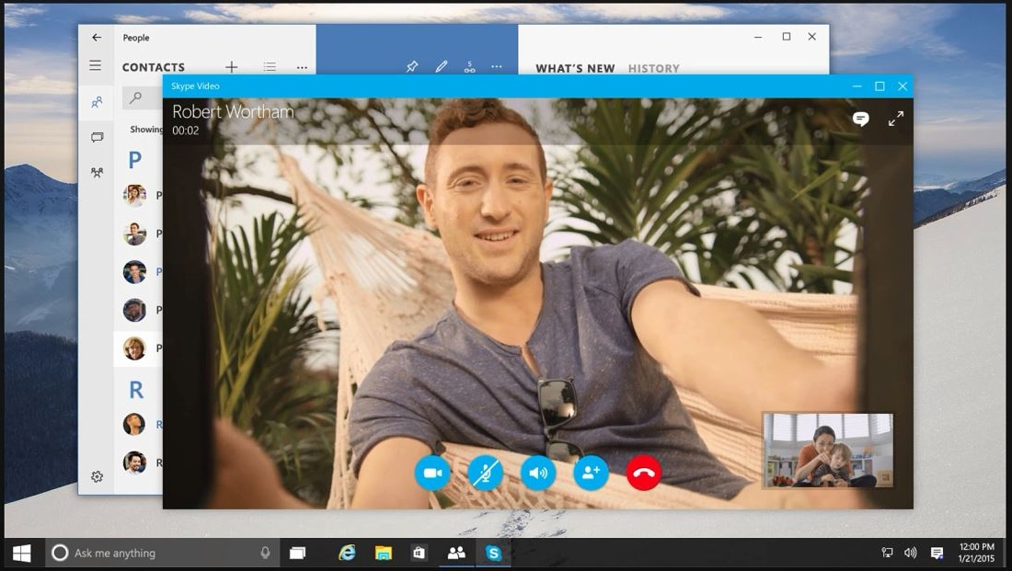
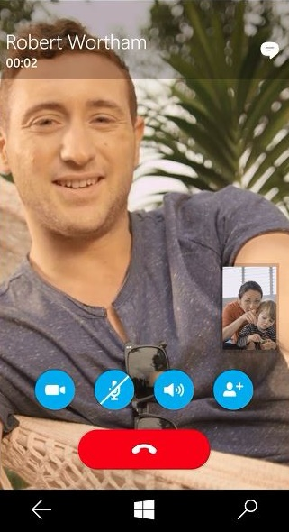
Adaptive design
Tablet (landscape) / Desktop
Phone (portrait)

Slide 22
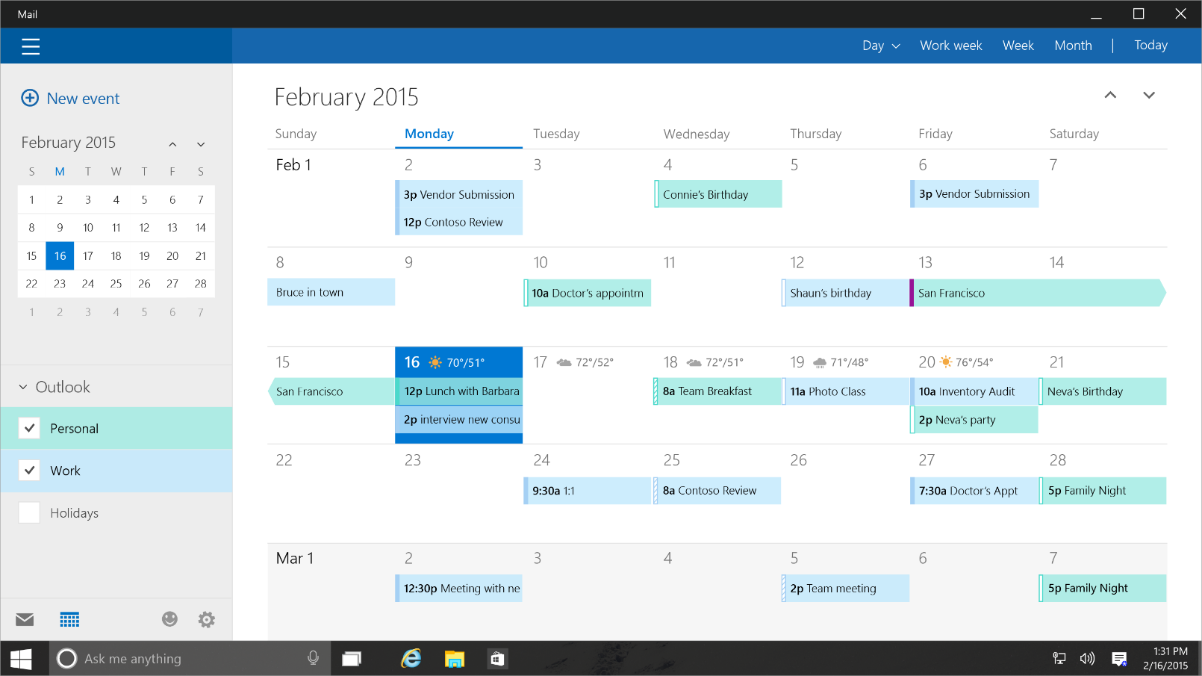
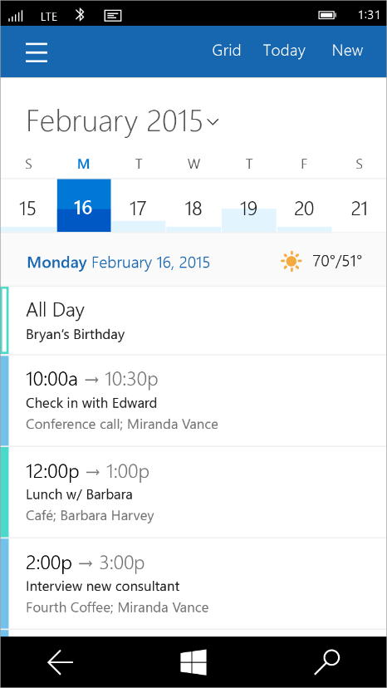
Tailored design
Tablet (landscape) / Desktop
Phone (portrait)

Slide 23
App Studio
Notes:
This shows off blend demo. I think Kat is going to cover this.

Slide 24
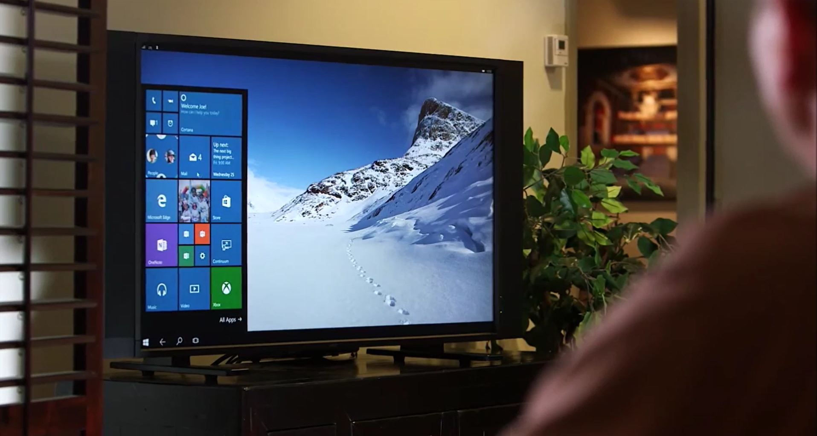
Continuum for Convertibles and Phones
Continuum for convertibles and Phones

Slide 25
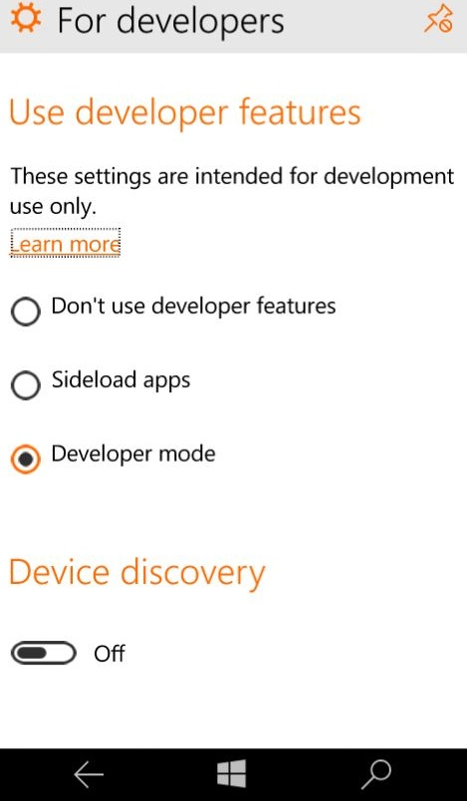
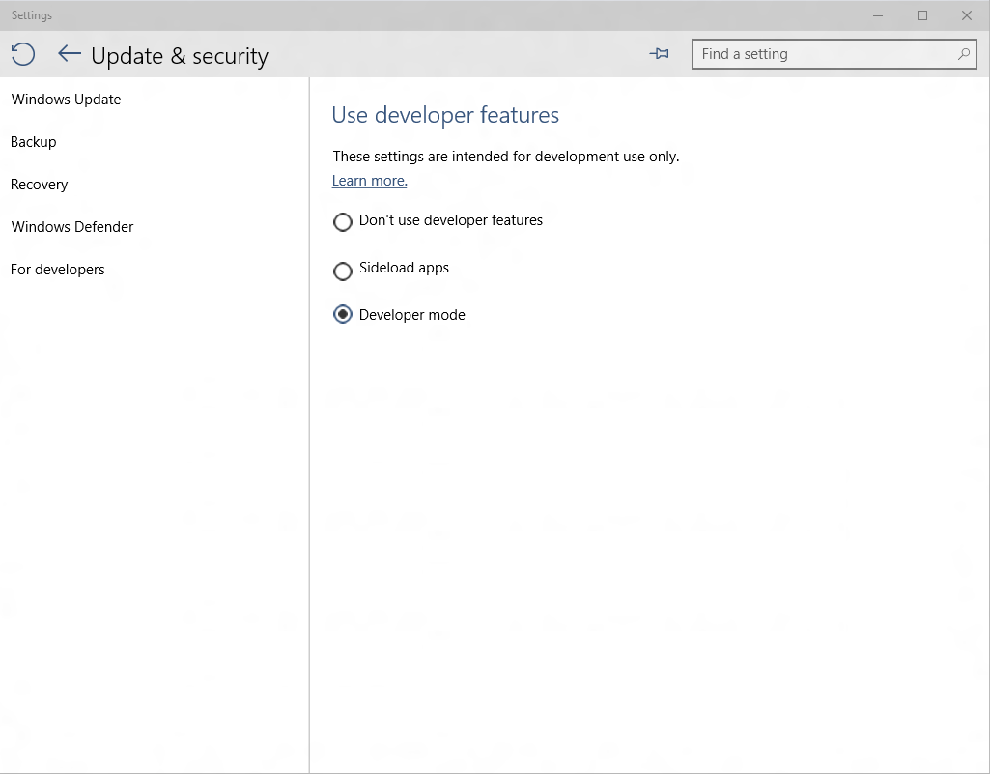
Developer unlock

Slide 26
.NET Native
Next generation compiler in the cloud
Every Windows apps, only Windows app (right now)
Apps use the standard C++ optimizer
As optimizer performance improves, so does .Net native
Apps with .Net bootstrapper
Includes garbage collection
There is no runtime
This is machine code

Slide 27
Every Windows app will be compiled with .Net Native

Slide 28
Real benefits with .Net Native
50% faster average startup time
14% less average memory usage

Slide 29
.Net Native enables the platform to update at a faster cadence

Slide 30
Universal Windows Platform
Wherever your code was born, you can bring it to Windows
Other Mobile Platforms
Project Astoria
Use your Java / C++ code
Use Android IDE
High code reuse
Project Islandwood
Use your Objective C code
Use Visual Studio
Medium-high code reuse

Slide 31


Online Microsoft training delivered by experts to help technologists continually learn
Hundreds of courses for developers, IT Pros, students, entrepreneurs and enthusiasts
11 different languages
3M students registered
Build your own Learning Plan
All free!
http://www.microsoftvirtualacademy.com

Slide 32
Technical Resources for Windows Devs
Visual Studio Community Edition (free): http://aka.ms/vsc2013
Ultimate Guide & FAQ to Setting-up a Windows Phone Dev Environment: http://aka.ms/wpdevsetup
Building Apps for Windows Blog: http://blogs.windows.com/buildingapps
Dvlup Challenges & Rewards: www.dvlup.com
Microsoft App Studio: http://appstudio.windows.com
Nick Landry’s Blog: www.AgeofMobility.com
Windows Phone Developer Magazine (online): http://flip.it/95YFG
Windows Phone 8.1 Jump Start Training: http://aka.ms/wp81js
Windows 8.1 Universal Apps Samples Pack https://code.msdn.microsoft.com/windowsapps/Universal-Windows-app-cb3248c3

Slide 33
Technical Resources for Cloud Devs
Get started with a free Azure trial and get $200 to spend for 30 days: http://aka.ms/trymsazure
Microsoft Azure Management Portal: https://manage.windowsazure.com
Microsoft Azure New Preview Portal: https://portal.azure.com/
Microsoft Azure Cloud Cover Show: http://channel9.msdn.com/Shows/Cloud+Cover
Azure Friday: http://friday.azure.com
AzureChatr App Sample with Push for Windows, iOS & Android: http://aka.ms/azurechatrblog
Visual Studio Community Edition (free): http://aka.ms/vsc2013

Slide 34

Thank You!
Contact me and let me know what you build, I will be happy to help promote your projects.
Blog: www.AndrewSMoll.com
Twitter: @AskTheData
Email: Andrew.Moll@microsoft.com
LinkedIn: www.linkedin.com/in/andrewmoll
GitHub: github.com/AndrewMoll

